Slide 1
Mental Health Text Risk Detector

Slide 2
Team 4
Mansi Karnatak
Anchal
Jyoti
Anuradha
Mahima

Slide 3

Work Division
Contribution of each team member in project
Mansi Karnatak (Leader): Manages project planning, coordination, final testing and final submission.
Jyoti (Database): Designs MySQL database, creates tables, and provides SQL queries and schema.
Anchal (Python – Add/View): Connects Python with MySQL and implements add and view expense functions.
Anuradha (Python – Update/Delete): Implements update and delete expense functionalities.
Mahima (Documentation/PPT): Prepares PPT, Documentation and screenshots.

Slide 4

The background
Earlier, people used notebooks or diaries to write down their daily expenses, which was slow and often inaccurate. Later, some used spreadsheets, but they still required manual work. In the past, expenses were checked only after seeing bank statements. Today, because of online payments and frequent spending, managing money has become more difficult. Therefore, a Daily Expense Tracker helps students easily record daily expenses, understand spending habits, and manage money better.

Slide 5
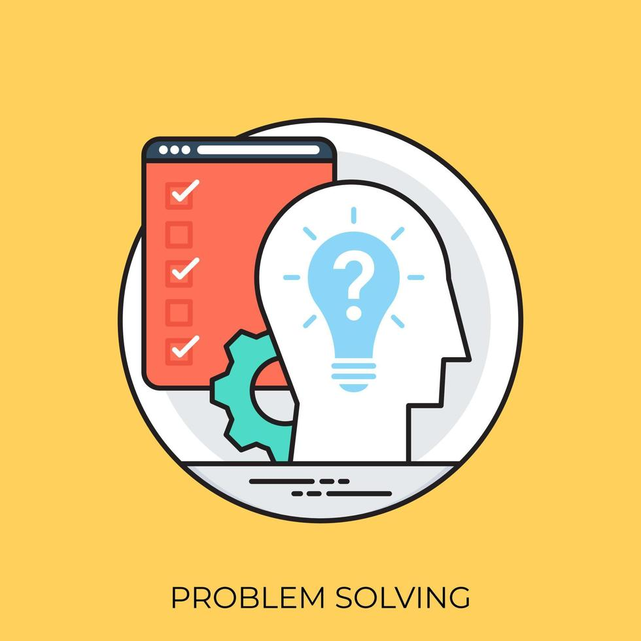
PROBLEM STATEMENT
Track daily expenses by storing date, amount, and category in a database.
Problem statement

Slide 6

Proposed Solution
The proposed solution is a Daily Expense Tracker that uses Python and MySQL to manage expense records efficiently. Users can add, view, update, and delete their daily expenses through a simple interface. All expense data is securely stored in a MySQL database for easy retrieval and modification. This system helps users track spending accurately and maintain organized financial records.

Slide 7

Technology Stack & Requirements
MySQL: MySQL is a relational database used to store data in tables. It is fast, secure, and can handle large amounts of data. In an expense tracker, MySQL stores user and expense information safely.
Python: Python is a high-level programming language that is easy to read and write. It provides frameworks like Flask and Django for backend development. In an expense tracker, Python handles business logic and data processing.

Slide 8

Innovative Idea
An innovative idea for a Daily Expense Tracker is smart auto-categorization of expenses using rules or basic AI to reduce manual work. The system can predict budget overuse and alert users before they exceed limits. It can also provide personalized spending insights and tips to help users save money.

Slide 9

Results / Outcomes / Analysis
Results / Analysis / Outcomes: The Daily Expense Tracker successfully records and manages daily expenses accurately. Users can clearly analyze their spending patterns through summaries and reports. The system helps identify unnecessary expenses and improves financial awareness.
Benefits of the Solution: The solution saves time by organizing expenses automatically. It helps users control budgets, reduce overspending, and develop better saving habits.

Slide 10

Limitations
The application relies on manual entry of expenses, which may lead to incomplete or incorrect data. It does not fully support automatic bank or payment app integration. Expense predictions and insights are limited by the amount of historical data available.

Slide 11
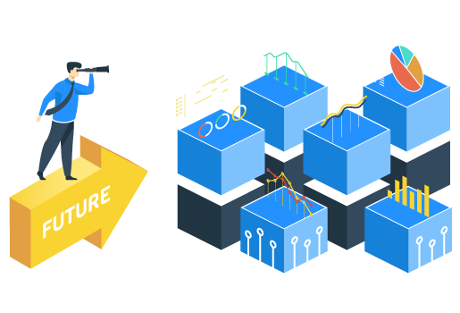
Future Scope
The future scope of a daily expense tracker includes adding automatic expense tracking from bank messages and bills. It can use smart features to predict future spending and suggest ways to save money. Cloud storage can allow users to access their data from multiple devices. The app can also include budget alerts and financial reports to help users manage expenses better.

Slide 12
karnatakmansi149/daily-expense-tracker

Slide 13
Thank You

